Slide 1

Department of Information Technology
Virtual Mouse Using Hand Gesture Course Code: KCS 354 Course Name: Mini Project CSE- 5th Sem 2023-24 (Odd Sem) Presented By –
Animesh Pratap Singh (2100970100014) Anmol Agrawal (2100970100019)
Akash Yadav (210097010009)
Mr. Youddhaveer Singh
Assistant Professor

Slide 2
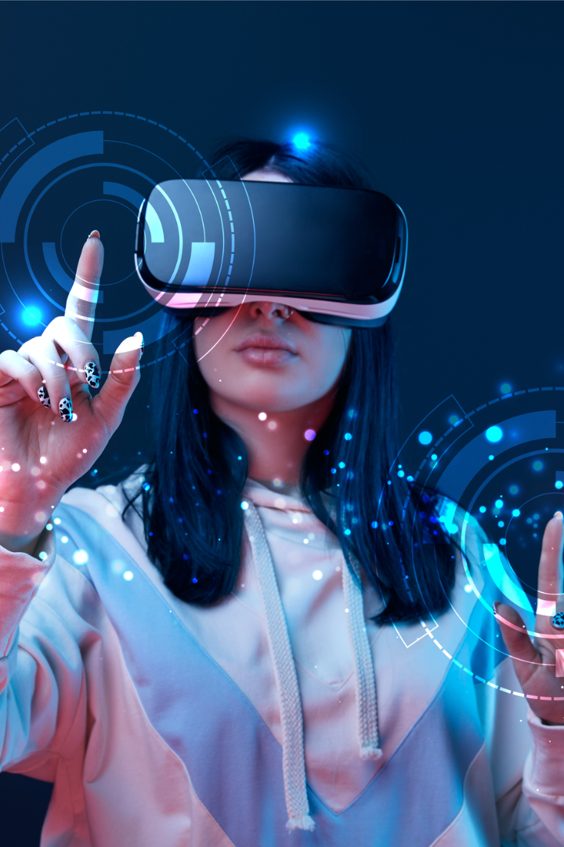
Virtual Mouse using Hand Gestures
Welcome to the world of virtual mouse control using hand gestures. Explore the exciting possibilities of this innovative technology in human-computer interaction.

Slide 3


Introduction
Definition of virtual mouse
The hand gesture is the simplest and most natural way to communicate among the various gesture communication
modalities, according to a survey and a study on sign language.
Real-time vision-based hand gesture identification for Human-
Computer Interaction is becoming more and more feasible
because to recent advances in computer vision and pattern recognition.
A virtual mouse is a computer input device that allows users to control the cursor and perform actions using hand gestures, eliminating the need for a physical mouse.
Importance of hand gestures in human-computer interaction
Hand gestures provide a natural and intuitive way for users to interact with computers, enhancing user experience and enabling more immersive interactions.

Slide 4
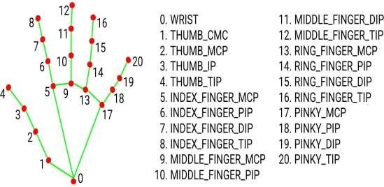
Hand Gestures as Input
Different types of hand gestures that can be used
1
Hand gestures can include movements such as swiping, pointing, pinching, and waving to control various aspects of the virtual mouse.
Examples of hand gestures for mouse control
2
For cursor movement, users can use gestures like moving their hand horizontally or vertically. For clicking, users can make a tapping or pinching gesture.
Figure : Hand Landmarks by Media Pipe

Slide 5
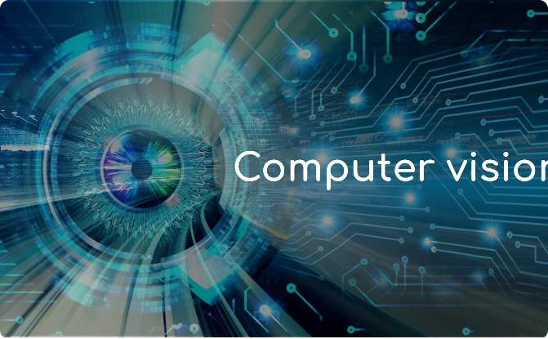
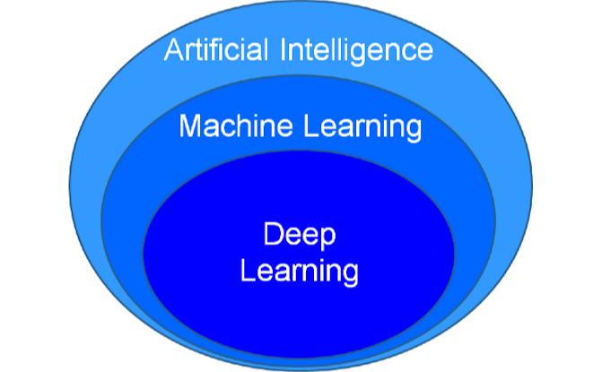
Tracking and Detection
Technology used for tracking hand movements
Techniques for hand gesture detection in real-time
Computer vision technology, combined with depth sensors or cameras, is used to track and capture hand movements accurately in real-time.
Deep learning algorithms analyze the captured hand movements, recognizing specific gestures and translating them into corresponding mouse actions.

Slide 6
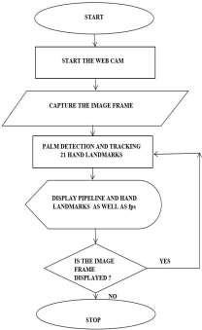
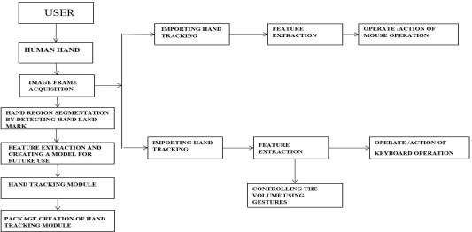
FLOWCHART
Figure : Block diagram of Mini Models
Figure 3: Flow of Hand tracking Model

Slide 7
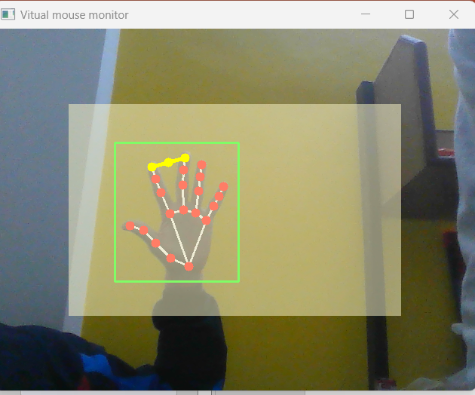
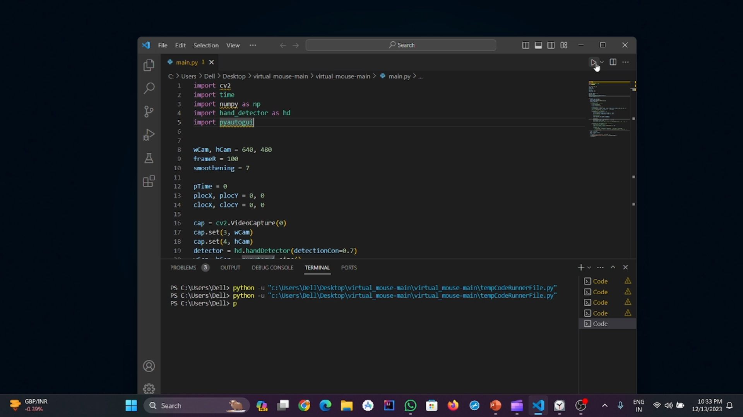
RESULT
Figure : Result of Hand Tracking Model
Tutorial : Performing the mouse actions

Slide 8
Conclusion
1
Recap of the main points discussed
We explored the concept of virtual mouse control using hand gestures, which offers natural and intuitive interaction possibilities for users.
2
Future possibilities of virtual mouse technology
As hand gesture recognition technology continues to evolve, the virtual mouse concept can expand beyond current limitations, improving human-computer interaction in innovative ways.

